Slide 1
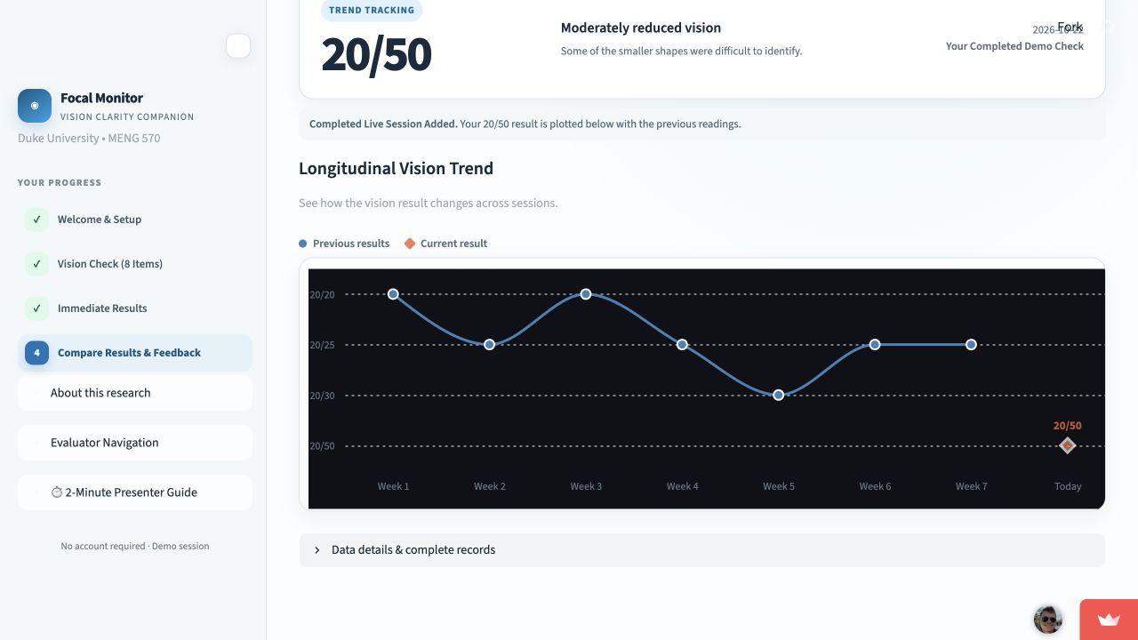
Focal Family
Investor pitch
A prepared next step for parents
Focal Technologies Team 5
Haydn, Fan, Qingyi, Burak and Hadley
01
Notes:
Focal Family
Presenter: Haydn
Timing: 0:00–0:30 (30 seconds)
A parent gets a school letter about their child's vision. The letter says what to do, but fitting that next step into family life is another job. Focal Family helps a parent capture what they have noticed and prepare the conversation that follows. We are seeking $600,000 to turn our working Family prototype into a product schools can buy and families can use for free. Fan will explain why we chose this problem.
Sources and assumptions
Team-selected product direction, October 30, 2026. Proposed investment terms and model.json.

Slide 2
The work after a school letter
Pat has a concern
The unfinished work
A school letter.
An observation at home.
A conversation to prepare.
Parents need to organize what they noticed and ask for help.
Staff still have to support and follow up with families.
Pat is an illustrative parent. Head Start guidance describes support and follow-up after a referral.
02
Notes:
The work after a school letter
Presenter: Fan
Timing: 0:30–1:25 (55 seconds)
Imagine Pat, a working parent of a six-year-old. A screening letter arrives, the child has been moving closer to a book, and Pat wants to speak with someone who can help. This is an illustrative story, not a customer testimonial. The parent has to remember observations, gather questions and arrange the next conversation. Staff may then need to contact the family again. Head Start's guidance explicitly includes family support and follow-up after referral. That is the workflow we want to improve. Focal Family gives the parent a useful output today: a note they can take to a school or eye appointment. A professional referral remains the reason to seek care. Completing our activity never determines whether care is needed.
Sources and assumptions
https://headstart.gov/publication/vision-screening-referrals
Customer-discovery workbook: Parent Pat is a hypothetical persona, not an observed customer journey.

Slide 3
Parents use it. Schools would pay.
The user
The proposed buyer
Parents of children
aged 4–10
District student services
School nurse champion
Trigger: a school letter or a concern raised by a parent or teacher.
Reason to pay: less follow-up work and clearer family next steps.
Discovery: 5 real interviews, including 1 parent, plus 5 AI simulations. Buyer demand and willingness to pay remain untested.
03
Notes:
Parents use it. Schools would pay.
Presenter: Fan
Timing: 1:25–2:15 (50 seconds)
Our first user is a parent of a child aged four to ten, especially after a screening letter or a concern raised at school. Our proposed buyer is a district student-services leader, with a school nurse as the day-to-day champion. The buyer would pay for less staff follow-up work and better visibility into the family's chosen next step. We need to prove both. Discovery included five real people and five AI-simulated interviews. Only one real interview was with a parent. That parent already kept examination records and described difficulty arranging appointments. This steered us toward preparation, but it does not prove demand for our product. Our next evidence must come from families using it and school buyers deciding whether it earns a budget.
Sources and assumptions
docs/research/customer-discovery/interview-workbook.docx: Fan, My Mother, in-person interview
docs/research/customer-discovery/presentation.pptx: slides 2 and 6
School buyer and purchasing case are proposed hypotheses.

Slide 4
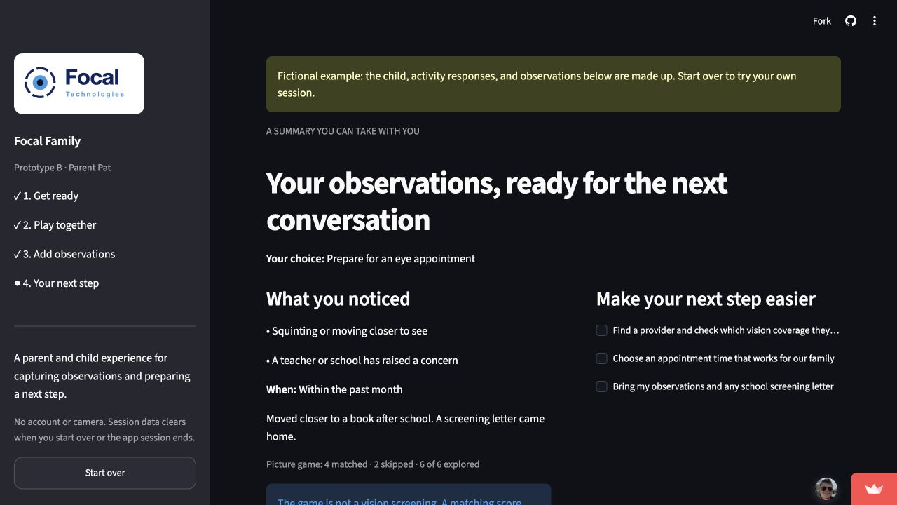
A parent note, ready to use
Focal Family today
A shared activity.
A parent-owned note.
The parent decides
Record observations, choose a next step and edit the message.
Our promise: help parents prepare a useful conversation about their child.
Activity, not vision screening. Screenshot shows the labeled fictional example.
04
Notes:
A parent note, ready to use
Presenter: Qingyi
Timing: 2:15–3:00 (45 seconds)
Here is what we have built. Parent and child learn the controls through a practice picture, then explore six large matching pictures. The parent records observations, chooses the next step and creates a summary. They can add questions and edit the message in their own words. The value proposition is a child-friendly activity that ends with an organized parent conversation. The screenshot uses the app's labeled fictional example. The pictures remain the same large size. They support engagement, not a vision measurement, diagnosis or reassurance that an examination can wait. We will now show the complete Family journey in three minutes.
Sources and assumptions
prototypes/prototype-b-parent-guided-check/README.md
Original Family summary screenshot in Focal Prototype Presentation.pptx, slide 5. Fictional example.

Slide 5
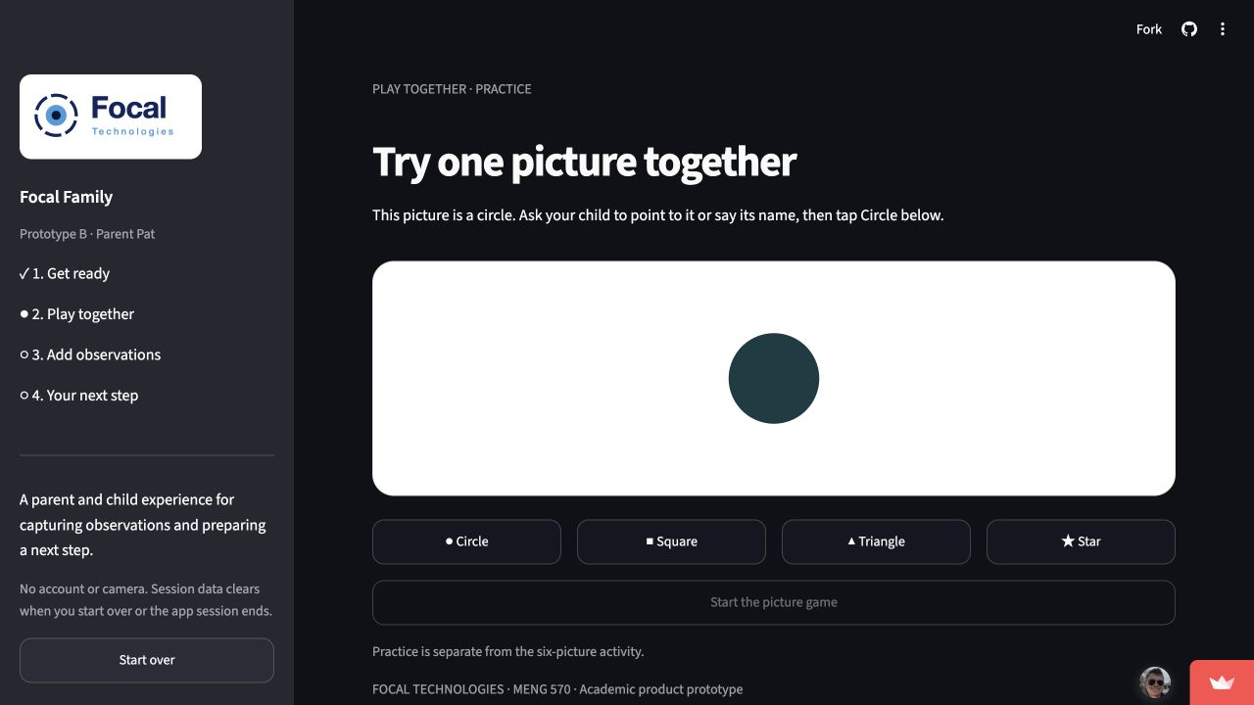
Focal Family live demo
3 minutes
focal-demo-b.streamlit.app
0:00 Practice and play
1:30 Add observations
2:00 Prepare and export
The output is a parent note,
not a medical result
05
Notes:
Focal Family live demo
Presenter: Qingyi 90s, Burak 90s
Timing: 3:00–6:00 (180 seconds)
0:00-0:20 Qingyi: Open the prepared fresh session. Choose an anonymous child label and an age group. Say: 'We will use made-up observations. A parent stays in control throughout.'
0:20-0:40 Qingyi: Click Let's play, match the practice circle and start the picture game. Say: 'Practice teaches the controls. It does not contribute a clinical result.'
0:40-1:20 Qingyi: Complete six pictures, skip one, and briefly show Take a break / resume only if ahead of schedule. Say: 'The activity makes room for the child. Matching performance is not a vision assessment.'
1:20-1:30 Qingyi: Enter the observations page and hand to Burak.
1:30-2:00 Burak: Select a parent observation, type 'Moved closer to a book after school' and choose appointment preparation. Create my summary.
2:00-2:35 Burak: Add a question, regenerate the draft and edit one sentence. Say: 'The parent chooses the action and the wording. This draft has not been sent anywhere.'
2:35-2:50 Burak: Request Download my summary. Point out the checklist and take-home note.
2:50-3:00 Burak: Say: 'Today this is preparation. Funding will let us test whether it improves real follow-through and build the school workflow.' Return to slide 6.
Fallback: After 10 seconds of a technical failure, switch to the preloaded fictional-example tab and explicitly identify it as fictional. If both tabs fail, use slide 5's practice screenshot and return briefly to slide 4's summary screenshot. Explain the same steps, then advance to slide 6 at 3:00. Never count a download as a completed appointment.
Sources and assumptions
https://focal-demo-b.streamlit.app/
prototypes/prototype-b-parent-guided-check/app.py and README.md. The editable message is a draft, not a sent message.

Slide 6
The investment tests follow-through
Working today | What the investment adds
Shared activity and parent observations | 10-site, 200-family feasibility pilot
Parent-selected next step and editable note | Measure completed actions and staff time
Session-only data and file export | Permissions, follow-up status and reporting
Pilot gate: +15 percentage points in completed next steps
Proposed target versus usual information at 30 days. No completed pilot, paying customer or clinical validation is claimed.
06
Notes:
The investment tests follow-through
Presenter: Burak
Timing: 6:00–6:55 (55 seconds)
The working prototype shows that we can deliver the parent experience. It does not yet demonstrate improved follow-through or willingness to pay. Our funded plan begins with a small usability round, followed by a proposed ten-site, two-hundred-family feasibility pilot. Both groups retain the school's usual referral information. We compare that with the same information plus Focal. We measure the chosen next step after thirty days, separating parent reports from independently confirmed actions. We also time staff follow-up. Our proposed gates are a fifteen-percentage-point improvement in completed next steps and enough staff time saved to support the price. We stop or revise if parents mistake the activity for a vision test. Partner status reporting, permissions and reminders are funded work, not features you just saw.
Sources and assumptions
Prototype capabilities: prototypes/prototype-b-parent-guided-check/README.md
Pilot size, endpoints, and success gates are proposed targets. No completed pilot or signed customer is documented in the repo.

Slide 7
We compete on the parent workflow
Alternative | What it does well | Where Focal would compete
Letters and staff calls | Familiar and personal | Guided preparation with less repeated staff work
GoCheck Kids | Professional screening and EHR integration | Parent preparation outside the clinical visit
Peek Vision | Screening, referral tracking and reminders | A focused parent-and-child experience at home
Proposed differentiation, not proven superiority. A future advantage depends on outcomes, distribution and renewals. Sources in notes.
07
Notes:
We compete on the parent workflow
Presenter: Fan
Timing: 6:55–7:50 (55 seconds)
The strongest alternative is the process schools already use: a referral letter, phone calls and staff judgment. It is familiar and inexpensive to start, so our product must demonstrate a worthwhile improvement. GoCheck Kids offers professional screening with a configured device and record-system integration. We would complement that clinical job. Peek is a more direct strategic competitor: it already offers screening, referral tracking and reminders. We cannot claim that nobody supports follow-up. Our proposed point of difference is a focused experience for a parent and child at home, with editable preparation that can fit an existing school process. These features are copyable. Defensibility would have to come from proven outcomes, trusted distribution and useful integration. We have to earn that advantage through pilots and renewals.
Sources and assumptions
https://headstart.gov/publication/vision-screening-referrals
https://www.gocheckkids.com/
https://peekvision.org/
https://peekvision.org/wp-content/uploads/2023/11/Peek-Vision-Brochure.pdf
Competitive fit and limitations are team analysis, not a head-to-head trial.

Slide 8
A school-first market worth testing
$125.9M
$12.6M
$1.32M
National school opportunity
Illustrative reachable subset
Year-three exit ARR target
52,450 public elementary schools × $2,400 per year
10% of sites assumed to fit the workflow and buying conditions
550 paid schools × $2,400 per year
NCES 2021–22 site-count benchmark. Price, 10% filter and adoption are assumptions. Private schools and practices excluded.
08
Notes:
A school-first market worth testing
Presenter: Haydn
Timing: 7:50–8:45 (55 seconds)
We size the opportunity using billable school sites, not the global number of people with vision problems. NCES reports 52,450 public elementary schools in the 2021-22 school year. At our proposed annual price of $2,400 per school, that represents a $125.9 million theoretical annual opportunity. That historical site count is a benchmark, not a current list of qualified buyers. For planning, we assume ten percent could match our workflow and buying conditions, or roughly $12.6 million. That filter is still unvalidated. Our year-three goal is 550 paying schools, producing $1.32 million in annual recurring revenue at year end. Pediatric practices and private schools may become expansion channels, but neither contributes to these numbers. First, we need evidence that a school pays and renews.
Sources and assumptions
https://nces.ed.gov/programs/digest/d22/tables/dt22_216.10.asp : Elementary row, 2021-22, 52,450
model.json: $2,400 price, 10% serviceable assumption and 550 year-three sites. Market dollars are calculations, not published market-research estimates.

Slide 9
One school pilot can open a district
40
10
50
Buyer conversations
Pilot sites
Paid sites by year-one end
Founder outreach to North Carolina school nurses and district leaders
Agree family and staff outcomes with the budget owner
Expand successful pilots through district contracts
Proposed funnel, not a committed pipeline. Districts may buy multiple schools. Procurement timing and budget fit require validation.
09
Notes:
One school pilot can open a district
Presenter: Haydn
Timing: 8:45–9:40 (55 seconds)
We would begin with founder-led outreach to school nurses and district student-services leaders in North Carolina. A screening letter provides a relevant moment for a parent to receive the link. We would recruit pilot sites, agree the outcomes with the budget owner and evaluate staff effort as well as family behavior. If a pilot meets those gates, we would sell an annual district contract priced by participating school. The year-one planning funnel is forty buyer conversations, ten pilot sites and expansion to fifty paying sites, potentially across five district contracts. These are targets, not a pipeline we already have. School purchasing is seasonal, and privacy and IT review can delay a sale. We will test that cycle before hiring a larger sales team. Pediatric partnerships come after the first school renewal evidence.
Sources and assumptions
Proposed go-to-market assumptions. No named institution or partnership is implied.
model.json: 50 paying sites at year-one end, net of cancellations.

Slide 10
$2,400 per school. Free for families.
75%
Annual unit economics | Per school
License revenue | $2,400
Hosting and messages | $240
Onboarding and support | $300
Billing and delivery tools | $60
Total COGS | $600
Modeled gross margin
$1,800 gross profit per site
16-month target CAC payback
Proposed pricing and costs. Payback assumes $2,400 acquisition cost. Buyer test: 60 hours saved × assumed $40/hour = annual fee.
10
Notes:
$2,400 per school. Free for families.
Presenter: Hadley
Timing: 9:40–10:35 (55 seconds)
Our proposed revenue model is an annual $2,400 license for each participating school, with families using the experience free of charge. A district can buy multiple schools on one contract. The paid product would include school-specific preparation materials, permitted follow-up status and staff reporting, once built and tested. We assume $600 in direct annual delivery cost per site: $240 for hosting and messages, $300 for onboarding and support, and $60 for billing and delivery tools. That leaves $1,800 in gross profit, or a 75 percent gross margin, before operating expenses. At a target acquisition cost of $2,400 per site, payback would take sixteen months. As a simple pricing test, saving sixty staff hours at a hypothetical forty dollars per hour equals the annual fee. We have not measured that saving.
Sources and assumptions
model.json. All prices, costs, acquisition targets and staff-time values are illustrative planning assumptions. No insurance reimbursement or referral commissions are assumed.

Slide 11
A route to $1.32M in year-end ARR
Illustrative forecast, starting when funded
USD thousands | Y1 | Y2 | Y3
Revenue | 42 | 324 | 960
COGS | 10.5 | 81 | 240
OPEX | 300 | 450 | 660
Operating result | -268.5 | -207 | 60
Year-end paid sites | 50 | 250 | 550
ARR is a year-end run rate, not annual revenue. Y3 break-even: 367 average sites. Assumes timely collections. Full model in backup.
11
Notes:
A route to $1.32M in year-end ARR
Presenter: Hadley
Timing: 10:35–11:45 (70 seconds)
This forecast starts when funding arrives. We model fifty paying schools at the end of year one, two hundred fifty at the end of year two and five hundred fifty at the end of year three. Revenue grows as those sites come online. Recognized revenue is $42,000, $324,000 and $960,000 across the three years. The $1.32 million headline is year-three exit recurring revenue, not revenue earned during that year. Direct costs remain twenty-five percent of revenue. Operating expenses grow from $300,000 to $450,000 to $660,000 as we build the product and distribution. That produces operating losses of $268,500 and $207,000, followed by a $60,000 operating surplus in year three. At the year-three cost base, break-even requires about 367 average active schools. A twenty-percent price reduction would turn that surplus into a $132,000 loss. This is a model of what must become true, not a prediction supported by current sales.
Sources and assumptions
model.json and calculated-model.json generated by build.mjs. Assumes linear site growth within half-years and collection in the same period. Excludes taxes, financing costs, capex and working-capital delays.

Slide 12
$600K funds the next 18 months
Use of funds | 18 months
Product and research | $260K
Pilots and sales | $110K
Privacy, security and review | $60K
Administration and insurance | $80K
Service delivery (COGS) | $36K
Reserve | $54K
Total | $600K
120 paid sites
Target at month 18
Pilot outcome evidence
Early renewal decisions
$546K planned cost before revenue
$54K reserve inside the raise
Proposed budget. Base-case 18-month revenue: $144K. Ending cash: $198K. Labor included with lean founder compensation.
12
Notes:
$600K funds the next 18 months
Presenter: Hadley
Timing: 11:45–12:40 (55 seconds)
The ask is sized to the work ahead. Over eighteen months we budget $260,000 for product development and research, $110,000 for pilot recruitment and sales, $60,000 for privacy, security and clinical-content review, $80,000 for administration and insurance, and $36,000 for direct service delivery. That totals $546,000 before revenue, with a $54,000 reserve inside the raise. Labor is included in these categories and assumes a lean team, not five full executive salaries. Our base case produces $144,000 of revenue during those eighteen months, leaving $198,000 in cash. We can fund the planned period even if that revenue does not arrive. By month eighteen, the target is evidence of improved follow-through, renewal decisions from early customers and 120 paying sites. We would stage hiring against those milestones.
Sources and assumptions
model.json: sum of first three half-years. Use-of-funds total equals $600,000 including reserve. Renewal, clinical-content review and site targets are proposed work, not completed achievements.

Slide 13
Five owners for the next milestones
Team member | Role | Milestone owner
Haydn Stucker | CEO | School access and fundraising
Fan Zhang | CCO | Customer evidence and messaging
Qingyi Hu | CPO | Parent experience and usability
Burak Donbekci | CTO | Delivery, security and integration
Hadley McCormack | CFO | Pricing, unit economics and runway
Next capability to recruit: pediatric eye-care and school-health advisers. Working prototypes demonstrate execution, not clinical expertise.
13
Notes:
Five owners for the next milestones
Presenter: Qingyi 25s, Burak 20s
Timing: 12:40–13:25 (45 seconds)
Qingyi, 25 seconds: 'Our five-person team has built and documented three product experiments, and we have selected Family for this pitch. Haydn will own school access and fundraising. Fan will own customer evidence and messaging. I will own the parent experience and usability research. The first milestone is a workflow families understand without help.'
Burak, 20 seconds: 'I will own delivery, security implementation and partner integration. Hadley will own pricing, unit economics and runway. We plan to recruit pediatric eye-care and school-health advisers. Those advisers are a hiring need, not credentials we already have. Each investment milestone has a named owner.'
Sources and assumptions
docs/strategy/business-model-presentation.pdf, slide 1: team names and roles
Prototype repository: working experiments. Future ownership is proposed for this pitch.

Slide 14
$600K for 15% equity
18 months to prove the business
Families take the next step
Schools see value and renew
Delivery supports sustainable economics
Proposed terms: $3.4M pre-money / $4.0M post-money valuation. A working Family prototype, with outcomes and buyer demand still to prove.
14
Notes:
$600K for 15% equity
Presenter: Haydn
Timing: 13:25–14:00 (35 seconds)
We are asking for $600,000 for fifteen percent of the company, an illustrative $3.4 million pre-money and $4 million post-money valuation. The investment funds eighteen months to prove that families take their next step, schools see enough value to renew, and delivery can support the economics we showed. The working parent experience is already here. The next milestone is a business that schools choose to pay for. Help us turn a parent's concern into a prepared conversation and a follow-through process schools can trust. Thank you. We welcome your questions.
Sources and assumptions
Proposed classroom financing terms, subject to negotiation. These are not existing financing commitments or a professional valuation. model.json.

Slide 15
Backup: the financial assumptions
Six-month period | Y1 H1 | Y1 H2 | Y2 H1 | Y2 H2 | Y3 H1 | Y3 H2
Average paid sites | 5 | 30 | 85 | 185 | 325 | 475
Revenue ($K) | 6 | 36 | 102 | 222 | 390 | 570
COGS ($K) | 1.5 | 9 | 25.5 | 55.5 | 97.5 | 142.5
OPEX ($K) | 135 | 165 | 210 | 240 | 310 | 350
Operating result ($K) | -130.5 | -138 | -133.5 | -73.5 | -17.5 | 77.5
Y3 sensitivity: price −20% gives −$132K operating result. Unit COGS +25% gives $0.
Revenue uses average sites. Cash assumes same-period collection. Net site targets require replacement of churn. No taxes, interest or capex.
15
Notes:
Backup: the financial assumptions
Presenter: Hadley
Timing: Backup, outside the 14-minute talk
Revenue uses average active paying sites, not year-end sites. First half-year averages are 5, 30, 85, 185, 325 and 475. Each average site earns $1,200 for a six-month period and costs $300 to serve. Operating expenses are fully detailed in model.json. Site counts are net of cancellations, so gross wins must also replace losses. Working capital is simplified. The acquisition-cost target is $2,400 per site, which implies 16 months of gross-profit payback at $150 per month. A 90% annual retention target remains untested. At a 20% price cut, year-three revenue becomes $768,000 while direct delivery costs remain $240,000, giving a $132,000 operating loss after $660,000 OPEX. At 25% higher unit delivery cost, year-three COGS is $300,000 and operating result is zero. No clinical billing, referral fee or family subscription is in the base case.
Sources and assumptions
model.json. All forward-looking figures are illustrative, not actual results.

Slide 16
Backup: the pilot must earn a renewal
Proposed pilot | Decision rule
10 sites, about 200 families | Usual information compared with usual information plus Focal
Usability and understanding | 80% finish unaided. 90% understand this is not screening.
30-day next-step completion | Target +15 percentage points. Separate reported and verified action.
School buyer value | Measure staff effort and test willingness to renew at $2,400/site.
Feasibility pilot, not a powered clinical efficacy claim. Preserve usual care. Predefine endpoints, missing-data treatment and consent.
16
Notes:
Backup: the pilot must earn a renewal
Presenter: Fan and Qingyi
Timing: Backup, outside the 14-minute talk
Proposed first study: 10 school sites, approximately 200 consenting families, usual information versus usual information plus Focal, allocated within sites where feasible. Never withhold or delay a professional referral. This is a feasibility design, not a powered clinical efficacy trial. Agree the selected next-step definition, observation window and measurement plan before enrollment. Primary proposed outcome: a completed family-selected school contact or appointment-related action within 30 days, report parent statements separately from verified completion. Attendance at an examination is a separate endpoint. Compare staff time spent per family. Predefine exclusions and report missing follow-up. Proposed gates: at least 80% unaided workflow completion, 90% understanding that it is not screening, a 15-point uplift in next-step completion versus usual information, and willingness to renew at the proposed price. The 15-point gate is a business decision threshold, not an established effect. If families misunderstand the activity or the buyer sees no return, revise before scaling.
Sources and assumptions
Prototype B README: original proposed usability criteria
New pilot proposal. Clinical and school partners must review study procedures before use.

Slide 17
Backup: evidence and competitive limits
Evidence we have | What it does not establish
5 real interviews, including 1 parent | Market demand, clinical accuracy or willingness to pay
5 AI-simulated interviews | Independent customer evidence
Working Family activity and note | Completed care, retention or staff time savings
Named alternatives already serve this area | Unique follow-up technology or a defensible moat
Peek already offers referral tracking and reminders. Focal must demonstrate better fit for the proposed parent workflow.
17
Notes:
Backup: evidence and competitive limits
Presenter: Fan
Timing: Backup, outside the 14-minute talk
One real parent described preserving historical records and inconvenience around examinations. That supports studying preparation, not a universal unmet need or willingness to pay. Five AI interviews helped generate hypotheses and are not validation. No measured Family conversion, school pilot, paid customer or renewal result appears in the repo. Existing letters and calls are the baseline to beat. GoCheck Kids focuses on professional screening and integrated clinical records. Peek already offers a screening-to-treatment pathway and automated reminders; it cannot be dismissed as merely an acuity app. Focal's proposed parent-and-child preparation focus is a hypothesis about adoption and fit. None of these comparisons establishes superior clinical performance, lower cost or a defensible patent. We should partner or integrate where incumbents already perform well.
Sources and assumptions
docs/research/customer-discovery/interview-workbook.docx
https://www.gocheckkids.com/
https://peekvision.org/
https://peekvision.org/wp-content/uploads/2023/11/Peek-Vision-Brochure.pdf

Slide 18
Backup: product boundaries and risks
Risk | How the funded plan addresses it
Parents mistake play for screening | Test comprehension. Keep clear limits and professional referrals.
Sensitive family or school information | Minimum data, permissions, access controls and adviser review
Slow purchasing or weak renewal | Pilot with a budget owner. Stage hiring against paid demand.
Incumbents copy the workflow | Build outcome evidence and distribution. Integrate where useful.
Current prototype: session memory and manual export only. No diagnosis, booking, sent messages, partner portal or compliance certification.
18
Notes:
Backup: product boundaries and risks
Presenter: Burak
Timing: Backup, outside the 14-minute talk
Today, the server holds session data in memory. There is no account, database, camera access, clinical measurement, automatic message sending, booking or partner portal. Users can export a note. Avoid identifying information in the prototype. Production partner reporting requires explicit permissions, minimum necessary data, role-based access, secure storage and a retention/deletion plan. Legal and clinical advisers must assess the intended use, school-data obligations and any health-data relationships before a pilot. We claim no regulatory clearance, compliance certification or diagnostic accuracy. The activity must never delay a referral. School budgets, low family engagement and incumbent copying are core risks. Stage spending against parent comprehension, measured action, buyer value and renewal evidence. The current deployment is a student demonstration, not the production architecture.
Sources and assumptions
prototypes/prototype-b-parent-guided-check/app.py, demo.py and README.md
Production safeguards and adviser review are proposed work. No legal conclusion is asserted.

Slide 19
Backup: sources and demo recovery
NCES: school count (2021–22)
Head Start: referral follow-up
GoCheck Kids: professional screening
Peek: screening and referral workflows
Focal Family: live demo
Demo recovery: preloaded fictional example, then screenshots on slides 5 and 4.
External sources checked October 30, 2026. Local evidence and full URLs in notes. All pricing, projections and funding terms are proposals.
19
Notes:
Backup: sources and demo recovery
Presenter: Any presenter
Timing: Backup, outside the 14-minute talk
External sources checked October 30, 2026. NCES uses the 2021-22 elementary-school count as a historical benchmark. Pricing and market filters are authored assumptions. Head Start provides context for referral follow-up, not endorsement of Focal. Competitor product claims come from their official websites and may change. Local sources are the customer-discovery workbook, business-model team roster, selected prototype deck and current Family README/code. Keep a fresh live tab and a second tab preloaded with Explore a fictional example. If the demo fails, explicitly say that the second tab is fictional. If offline, show slide 5's practice screen and slide 4's summary screen, explain the interaction and rejoin slide 6. Stop the demo at three minutes. Backup slides are outside the fourteen-minute main talk.
Sources and assumptions
https://nces.ed.gov/programs/digest/d22/tables/dt22_216.10.asp
https://headstart.gov/publication/vision-screening-referrals
https://www.gocheckkids.com/
https://peekvision.org/
https://peekvision.org/wp-content/uploads/2023/11/Peek-Vision-Brochure.pdf
https://focal-demo-b.streamlit.app/

